Slide 1



Project Presentation Week 1
Lilian Mirabel – Florian Chapoullie-Pino
Luc Lacotte – Floris Rimbeau
Infinite Possibilities

Slide 2

Project Objective
The project aims to make strategic decisions to improve productivity.
The project aims to make strategic decisions to improve productivity.
The project aims to make strategic decisions to improve productivity.
The project aims to make strategic decisions to improve productivity.
Sales monitoring
detection of at-risk SKUs
The project aims to make strategic decisions to improve productivity.
- Sales monitoring
- Automatic restocking
- Detection of at-risk SKUs
Boost with Agentic AI
- Real-time data, autonomous decisions, …
Infinite Possibilities
Notes:
Luc

Slide 3
Goal of Week 1
Install and configure the necessary tools and technologies
Designing the database schema
Designing the database schema
Generate and import summary data
Goal of Week 1
- Install and configure the necessary tools and technologies - Automatic restocking
- Designing the database schema
- Generate and import summary data
- Analysing data with AI
- Verify data consistency
- Other tasks
Infinite Possibilities
Notes:
Luc

Slide 4
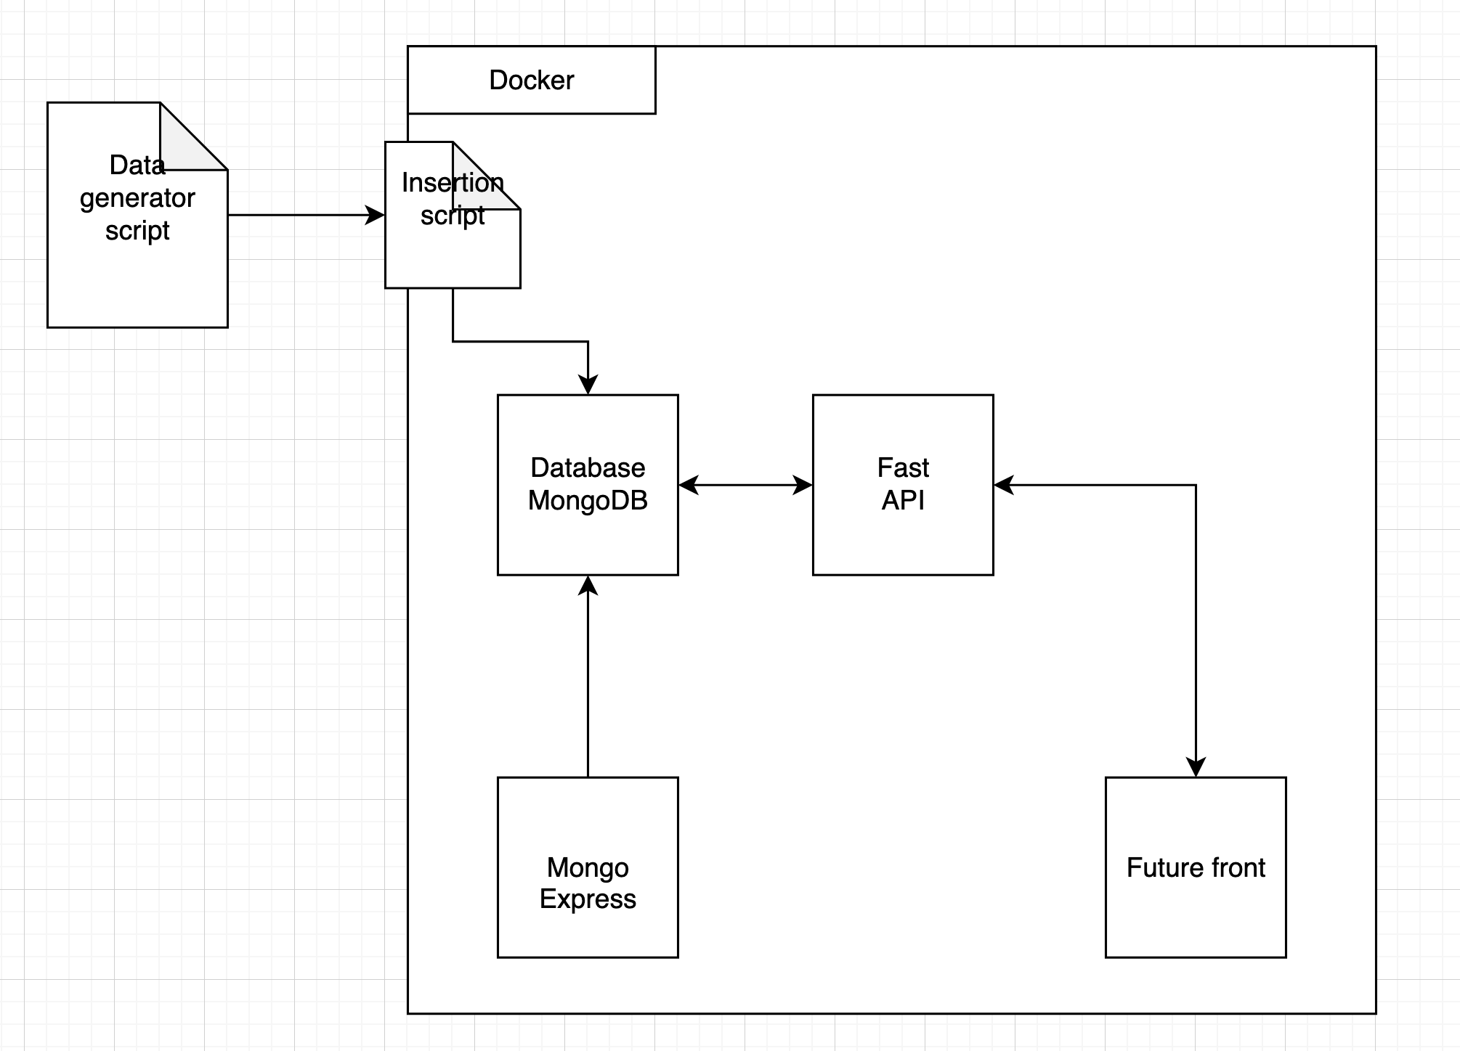
General technical architecture
9. Prochaines étapes (Semaine 2)
Notes:
luc

Slide 5

Database Design
Links between collections via SKU
MongoDB database
Multiple connections
- products
- sales
- stock
- purchase_orders
Links between collections via SKU
Notes:
floris

Slide 6
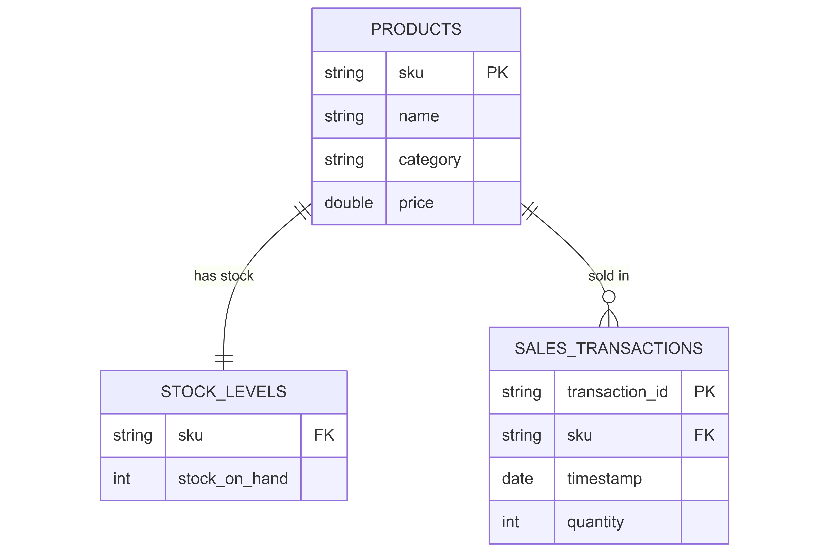
Goal of Week 1
Install and configure the necessary tools and technologies
Designing the database schema
Designing the database schema
Generate and import summary data
Infinite Possibilities
Notes:
floris

Slide 7

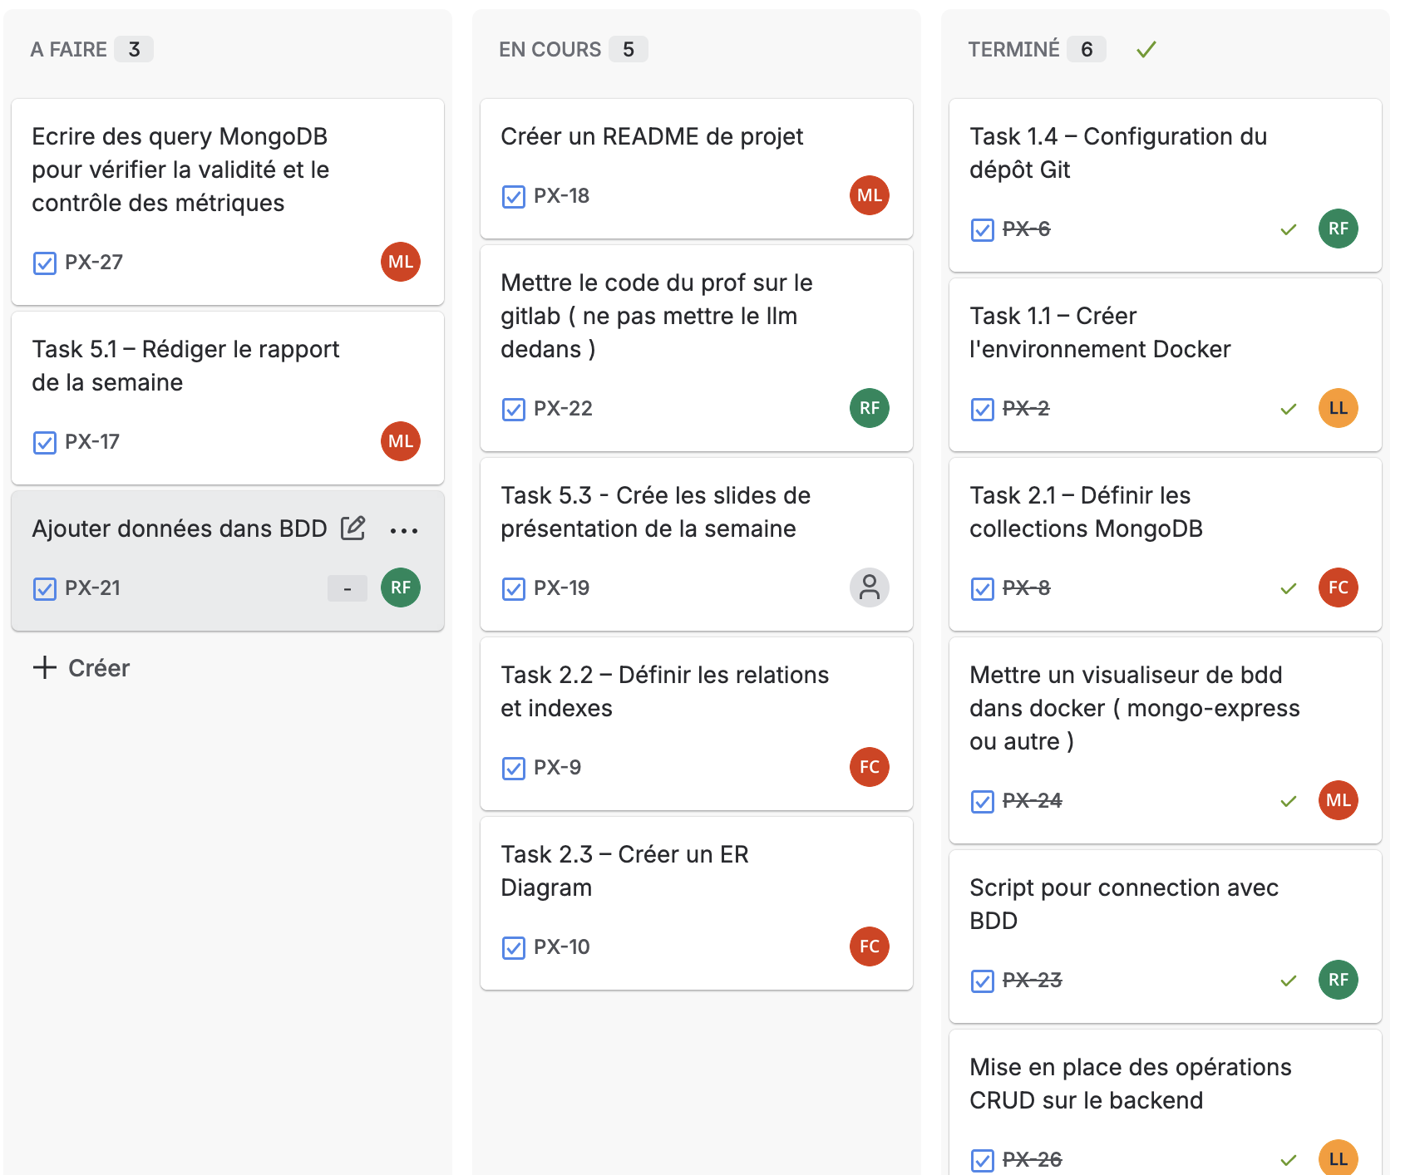
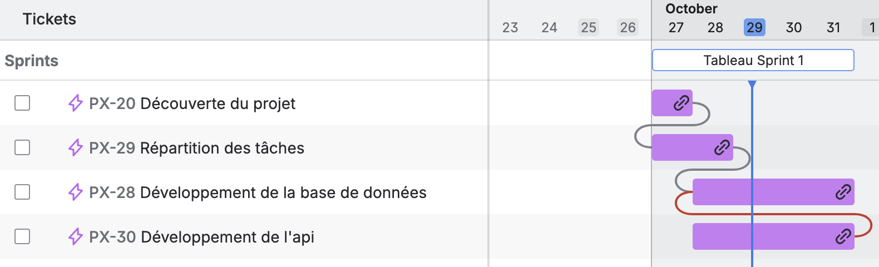
Organisation
We have organised ourselves with Jira for the distribution of work.
Notes:
lilian

Slide 8
Challenges encountered
Complication in creating the script for inserting data into the database
Incorrect task identification
Difficulty in distributing/parallelising different tasks
Notes:
florian

Slide 9
Next steps for Week 2
- Front-end development with React
- Integration of an open source AI model
- Backend development with MCP Server
With the deliverables
- Demonstration of the complete workflow
- Operational MCP API connected to MongoDB
9. Prochaines étapes (Semaine 2)
Notes:
florian

Slide 10
Conclusion
The project aims to make strategic decisions to improve productivity.
The project aims to make strategic decisions to improve productivity.
The project aims to make strategic decisions to improve productivity.
The project aims to make strategic decisions to improve productivity.
Sales monitoring
detection of at-risk SKUs
This week has been very useful in helping us to fully understand the project and what is at stake.
We have learnt to work in a group, communicate and organise ourselves for the tasks.
We hope that next week we will have a conclusive result with the implementation of the AI agent.
Infinite Possibilities
Thank you for listening.
Notes:
lilian

